Slide 1

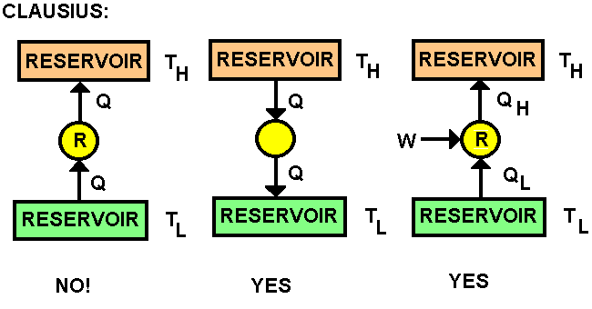
Second law of thermodynamics

Slide 2
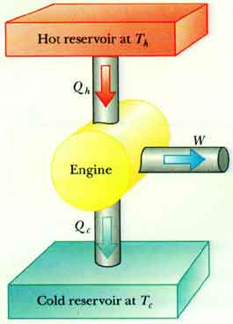
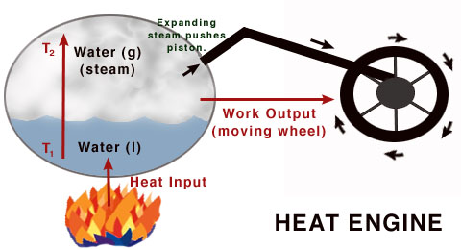
Conversion of Heat to Work

Slide 3
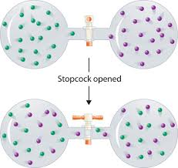

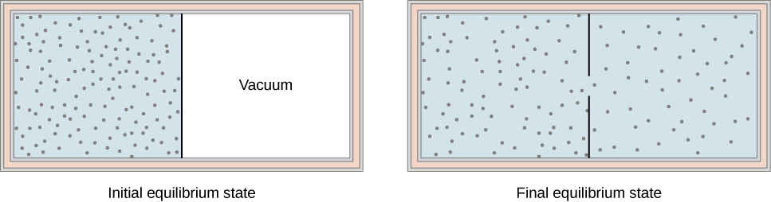
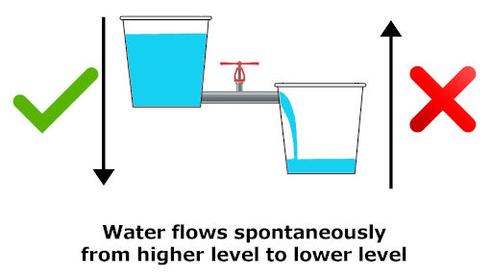
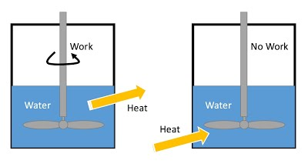
Spontaneity/Irreversibility

Slide 4
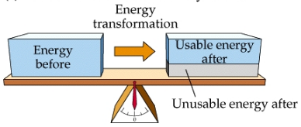
Quality of Energy: potential to do Work
Principle of Degradation of Energy

Slide 5
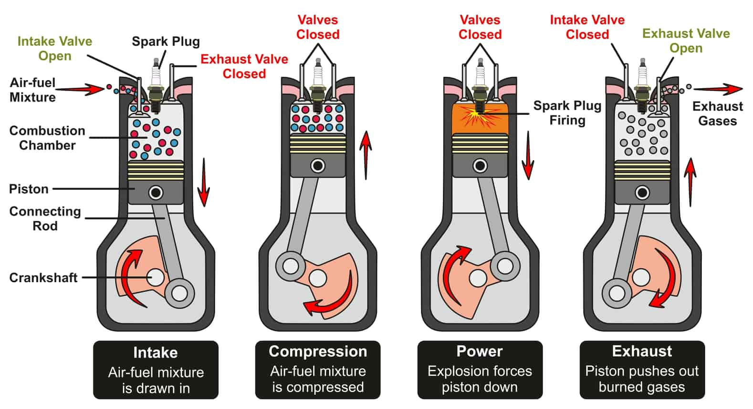

Slide 6
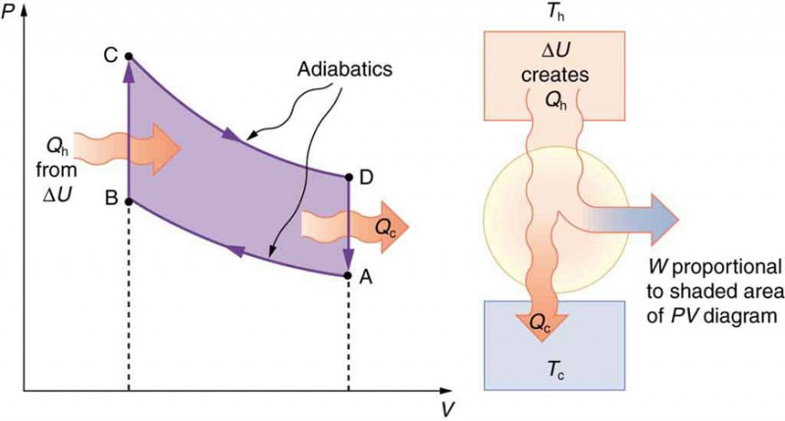

Slide 7
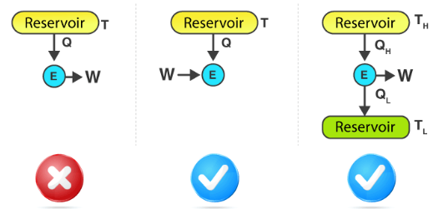
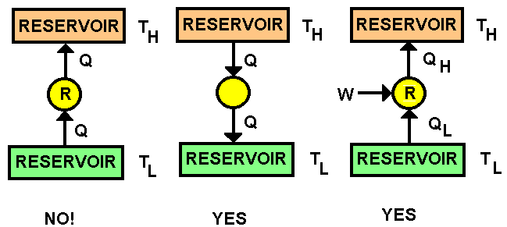
Kelvin-Planck statement: it is impossible for any device that operates in a cycle to receive heat from a single reservoir and produce a net amount of work.
Clausius statement: It is impossible to construct a device that operates in a cycle and produces no effect other than the transfer of heat from a lower-temperature body to a higher-temperature body.

Slide 8
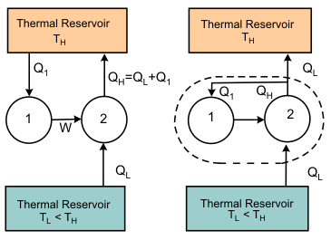
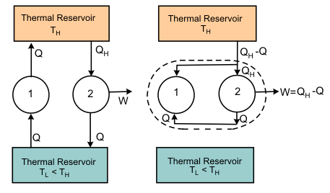
Equivalence of Kelvin-Planck & Clausius statement
The method shown above is just one of the many ways to show Equivalence of Kelvin-Planck & Clausius statement.
One can find other ways also to check this equivalence.

Slide 9

Entropy & Quality of Energy (potential of doing work)
Energy (E) = Available Energy for work + Unavailable Energy for work
E = E_{AV} + E_{UA}
Can be determined by extracting work from system quasi-statically.
A gas at higher pressure has more capacity to do work as compared to gas at low pressure.
Heat can be converted completely into work even through the reversible path.
Work can be completely converted into heat.
Work (high quality energy) → Heat (low quality energy)
Principle of Degradation of Energy:
_{Generation of Entropy:}

Slide 10

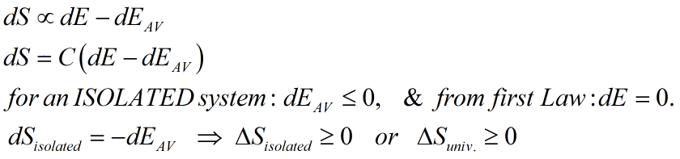
Principle of Degradation of Energy: For an Isolated system, the quality of energy never
remains conserved, it always degrades.

Slide 11
Thermal Reservoir: A body having significantly large heat capacity as compared to the amount of heat transfer involved in a process, so that the temperature of reservoir practically remains constant, such as our atmosphere, a large sized furnace, sea, a pure substance undergoing phase change .
Work Reservoir: A body having significantly large heat capacity as compared to the amount of heat transfer involved in a process, so that the temperature of reservoir practically remains constant, such as our atmosphere, a large sized furnace, sea, a pure substance undergoing phase change .

Slide 12
Important Concepts to remember:
- reversible heat transfer in the strict sense is not possible, however, in a practical sense it is possible if heat transfer takes place due to infinitesimally small temperature difference between system and surrounding. This leads to the concept of the thermal reservoir: a single body having very large heat capacity as compared to heat transfer involved in the process so that practically temperature of reservoir (as surrounding) remains almost constant, thus surrounding is always restored while reversing the direction of an internally reversible process. - reversible process: both system and surrounding should be restored to the initial state while reversing the direction of the process from final to the initial stage. (in strict sense not possible, practically possible) - maximum thermodynamic work can be extracted from the system through a reversible path. hence W(rev) is always maximum while going from stage 1 to stage two, thus if there is any irreversibility in the process (stage1 to 2), W(by system)<W(rev). - heat can be converted completely into work in a unidirectional process, if we can minimize all friction and other losses....however, if the process/device is working cyclically, 100% conversion is impossible (KP statement) - transfer of heat from low to high temp. body is impossible without any external work. (Clausius statement)

Slide 13
Thermal Reservoir: A body having significantly large heat capacity as compared to the amount of heat transfer involved in a process, so that the temperature of reservoir practically remains constant, such as our atmosphere, a large sized furnace, sea, a pure substance undergoing phase change .
The main advantage of above definition is that heat interaction for a thermal reservoir always occurs in reversible (not strictly) manner.
Work Reservoir: A system which only takes or delivers work, and there is no heat transfer across the system boundary, is considered a work reservoir. Examples: a spring pistion system, a rotating shaft.

Slide 14
Carnot cycle/engine: A body having significantly large heat capacity as compared to the amount of heat transfer involved in a process, so that the temperature of reservoir practically remains constant, such as our atmosphere, a large sized furnace, sea, a pure substance undergoing phase change .
The main advantage of above definition is that heat interaction for a thermal reservoir always occurs in reversible (not strictly) manner.
Work Reservoir: A system which only takes or delivers work, and there is no heat transfer across the system boundary, is considered a work reservoir. Examples: a spring pistion system, a rotating shaft.

